Slide 1

Text Classification on Toxic Comments
Ci Song, Shuo Wang
DATASCI 266 NLP with Deep Learning
2024 Spring

Slide 2




Agenda
Introduction
Methods
Experimentation Results and Discussion
Model Evaluation Metrics Summary

Slide 3
Introduction
Revolution in Text Analysis
Challenges in Detecting Toxicity
Notable Research Contributions
Project Focus
State-of-the-art models like BART, BERT, ALBERT, DistilBERT, and RoBERTa enhance language understanding tasks.
Subtle linguistic cues and context-dependent expressions complicate classification.
Khieu and Narwal's LSTM model: 87% accuracy
Chu and Jue’s RNN with LSTM: 93% accuracy
Xie et al’s Ensemble Method: 0.9485 AUC
Focus on Transformer-Based Models: Comparison of BART, BERT, ALBERT, DistilBERT, and RoBERTa
Assessment of model performance and accuracy for toxic comment classification
Notes:
Today, we're exploring the cutting-edge NLP algorithms like BART, BERT, ALBERT, DistilBERT, and RoBERTa, which have significantly improved text classification. We'll discuss their role in identifying toxic comments, the challenges faced, and the potential impact of our research on automated moderation systems.
We've seen remarkable progress in the field of toxic comment classification, with studies leveraging LSTM models and deep learning algorithms to achieve high accuracy rates and AUC scores.
Recent studies have made significant strides in classifying toxic comments. Notably, LSTM models achieved 87% accuracy, while deep learning algorithms reached 93%. An ensemble method even attained an AUC of 0.9485 for multilingual classification.

Slide 4



Dataset
Dataset Source and Content
Jigsaw (Google)’s Toxic Comment Classification Challenge data
Contains 159k+ human-labeled comments for toxic behavior
Data Preprocessing
Unbalanced data led to binary labeling: 'Toxic' or 'Non-Toxic'
Random selection of 40% training data to downsize while maintaining label ratio
Training dataset consists of 64K comments post-downsizing
Language Considerations
Inclusion of multilingual BERT and RoBERTa to handle comments in multiple languages
Notes:
We're examining Jigsaw's dataset with over 159k comments, labeled for toxicity. The data was unbalanced, prompting binary labeling and a downsizing strategy, maintaining the toxic ratio. Multilingual models were adopted to address the language diversity.

Slide 5
Methods: Baseline Configuration
CountVectorizer & Naive Bayes Classifiers
Complement Naive Bayes (CNB) for word count-based features
Multinomial Naive Bayes (MNB) for traditional Naive Bayes approach
Model | Accuracy | Precision | Recall | F1 Score | ROC AUC
CountVectorizer - CNB | 0.89 | 0.92 | 0.89 | 0.90 | 0.8
CountVectorizer - MNB | 0.91 | 0.92 | 0.91 | 0.92 | 0.78
TfidfVectorizer - CNB | 0.91 | 0.90 | 0.91 | 0.91 | 0.70
TfidfVectorizer - MNB | 0.92 | 0.91 | 0.92 | 0.89 | 0.58
TF-IDF Weighted Features
TfidfVectorizer paired with CNB and MNB models
Adaptation for Imbalanced Datasets
CNB variants adjust weights using class complements
Comparison with Advanced Models
Performance measured against BERT and RoBERTa embeddings
Notes:
Our baseline configurations employ CountVectorizer and Naive Bayes classifiers, with a focus on word count and TF-IDF features. They're designed to address imbalanced datasets and set a performance benchmark for comparison with sophisticated models like BERT and BART.

Slide 6




Methods: BART
Adoption of BART Architecture
Model Specifications
Output Processing and Optimization
Performance and Accuracy
Utilizes 'facebook/bart-large' checkpoint for diverse text generation tasks
Employs transformer-based model with sequence classification head
Handles input up to 256 tokens
Encoder-decoder architecture processes the input
Logits passed through flattening layer and dense layer with sigmoid activation
Optimized with a learning rate of 0.00001 using Adam optimizer
High-stakes classification accuracy of 0.92
Precision: 0.94
Recall: 0.92
F1: 0.93
ROC AUC: 0.9666
Notes:
Our presentation focuses on the BART architecture, specifically fine-tuned for binary classification. We'll explore its utilization of the 'facebook/bart-large' checkpoint, input processing through an encoder-decoder architecture, and the impressive 92% classification accuracy achieved through careful optimization.

Slide 7



Methods: BERT
Adaptation of BERT's Language Understanding
Model Structure and Components
Performance and Accuracy
Leverages 'bert-base-multilingual-cased' checkpoint
Binary classification using BERT's pooled output
Dense layer with 201 hidden units and ReLU activation
Dropout layer with a rate of 0.3 to prevent overfitting
Final dense layer with sigmoid activation for class probability
Adam optimizer and binary cross-entropy loss
Achieved an accuracy of 0.91
Precision: 0.94
Recall: 0.91
F1: 0.92
ROC AUC: 0.9622
Notes:
Exploring the BERT-based classification model, we utilize the multilingual 'bert-base-multilingual-cased' checkpoint for binary classification. The model includes a dense layer with ReLU activation, dropout for regularization, and a sigmoid output layer, achieving a high accuracy of 91%.

Slide 8

Methods: BERT-CNN Hybrid Model
Hybrid Model Integration
Feature Extraction with CNN
Global Max-Pooling
Regularization and Decision Making
Performance and Accuracy
Combines BERT's contextual embeddings with CNN's pattern recognition
Utilizes varied kernel sizes for n-gram feature capture
Selects salient features from CNN layers
Includes dropout layer and sigmoid-activated dense layer
Achieved 0.89 accuracy
Precision: 0.94
Recall: 0.89
F1: 0.90
ROC AUC: 0.9657
Notes:
Introducing the BERT-CNN Hybrid Model, a powerful combination of BERT's contextual understanding and CNN's pattern recognition, designed to capture both global and local textual features for superior classification accuracy.

Slide 9
Methods: DistilBERT
Model Architecture and Efficiency
Classification Head Details
Enhanced Generalization
Output Layer and Optimization
Performance and Accuracy
Based on 'distilbert-base-uncased' for English processing
Transformer layers condense text into sequence embeddings
Starts with the first token's embedding
Dense layer with 275 hidden units and ReLU activation
Dropout layer with a rate of 0.3
Sigmoid activation function for binary classification
Adam optimizer with binary cross-entropy
92% accuracy
Precision: 0.94
Recall: 0.92
F1: 0.93
ROC AUC: 0.9704
Computational efficiency
Notes:
Our DistilBERT-based model leverages the 'distilbert-base-uncased' checkpoint for English, utilizing transformer layers and a classification head with ReLU activation for efficient binary text classification. It achieves a notable 92% accuracy with significant computational savings.

Slide 10
Methods: ALBERT
Model Architecture and Efficiency
Robustness and Output
Performance and Accuracy
A Lite BERT' optimizes performance with fewer parameters
Utilizes 'albert-base-v2' checkpoint for language processing
Starts with ALBERT's pooler output for dense input representation
Incorporates a dense layer with ReLU activation and 201 hidden units
Features a dropout layer with a 0.3 rate to prevent overfitting
Employs sigmoid activation for binary classification output
Compiled with Adam optimizer focusing on accuracy
Achieved an accuracy of 0.89
Precision: 0.94
Recall: 0.89
F1: 0.90
ROC AUC: 0.9689
Notes:
The ALBERT-based classification model strikes a balance between complexity and performance. It uses a streamlined architecture with shared parameters and a focus on accuracy, achieving a 89% accuracy rate.

Slide 11
Methods: RoBERTa
Model Architecture
Input Processing
Model Structure and Optimization
Improved Performance and Accuracy
Based on XLM-RoBERTa, optimized for multiple languages
Employs dynamic masking, larger batches, and more data than BERT
Handles tokenized text with input_ids and attention_mask
Accommodates sequences up to a maximum predefined length
Extracts hidden state of 'CLS' token for classification
Includes a dense layer with 275 units and ReLU activation
Output layer with sigmoid activation for class probability
Achieved highest accuracy 0.93
highest precision 0.94
highest recall 0.93
highest F1 score 0.93
high ROC AUC 0.9664
Notes:
We've developed a binary classification model using the advanced XLM-RoBERTa architecture, which excels in multi-language understanding. Our model processes tokenized text and utilizes a transformer core for accurate classification, enhanced by an additional dense layer. It's optimized for accuracy, achieving an impressive 93%.

Slide 12
Experimentation Results and Discussion
Model | Accuracy | Precision | Recall | F1 Score | ROC AUC | Run Time | Hardware
CountVectorizer - CNB | 0.89 | 0.92 | 0.89 | 0.90 | 0.8126 | <10s | CPU
CountVectorizer - MNB | 0.91 | 0.92 | 0.91 | 0.92 | 0.7830 | <10s | CPU
TfidfVectorizer - CNB | 0.91 | 0.90 | 0.91 | 0.91 | 0.7022 | <10s | CPU
TfidfVectorizer - MNB | 0.92 | 0.91 | 0.92 | 0.89 | 0.5763 | <10s | CPU
BART | 0.92 | 0.94 | 0.92 | 0.93 | 0.9666 | 2.86 h | V100-High RAM
BERT | 0.91 | 0.94 | 0.91 | 0.92 | 0.9622 | 3.67h | T4 GPU
BERT+CNN | 0.89 | 0.94 | 0.89 | 0.90 | 0.9657 | 3.8h | T4 GPU
DistilBERT | 0.92 | 0.94 | 0.92 | 0.93 | 0.9704 | 1.77h | T4 GPU
ALBERT | 0.89 | 0.94 | 0.89 | 0.90 | 0.9689 | 3h | T4 GPU
RoBERTa | 0.93 | 0.94 | 0.93 | 0.93 | 0.9664 | 3.72h | T4 GPU
Model Performance Overview
CountVectorizer with Naive Bayes classifiers as baseline
Advanced models like BART, DistillBERT and RoBERTa show superior performance
Key Performance Metrics
Accuracy, Precision, Recall, F1 Score, ROC AUC considered
Deep Learning Model Advantages
RoBERTa outperforms all models across metrics
DistilBERT has the highest ROC AUC, with only ½ running time than RoBERTa
Notes:
Our project compared various text classification models, highlighting the superior performance of transformer-based models like BART, BERT and RoBERTa over baseline Naive Bayes classifiers, with RoBERTa leading in all evaluated metrics.

Slide 13
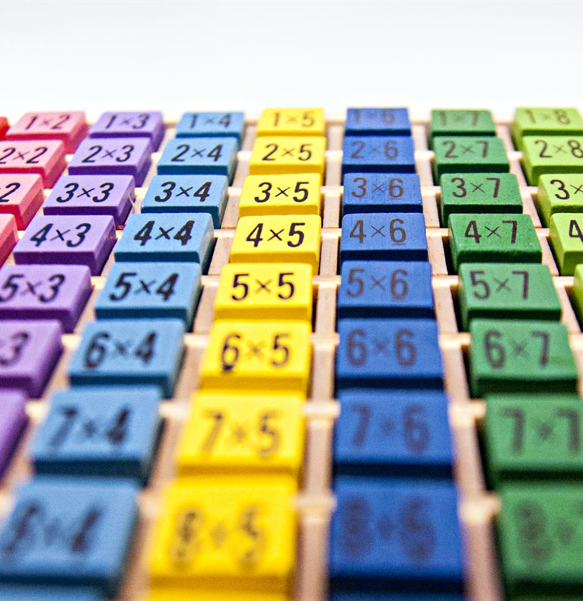
Conclusion
Advanced Deep Learning Models Outperform Traditional Methods
Models like BART, BERT, distilBERT, ALBERT, and RoBERTa show superior performance.
Transformer-based models excel in understanding context and semantics.
RoBERTa Leads in Performance Metrics
Marginally outperforms in ROC AUC, accuracy, precision, recall, and F1 score.
Established as the premier model for toxic comment classification.
Significance for Automated Moderation Tools
Advancements promise more effective management of online toxicity.
Practical solutions for automated moderation are within reach.
Future Work
Balance Data for multiclass classification
Deal with Resource Exhausted Error
Notes:
Our study reveals the exceptional performance of BERT and RoBERTa models in classifying toxic comments, outshining traditional methods. RoBERTa, in particular, stands out as the best model, demonstrating the power of transformer-based NLP technologies in enhancing text classification and offering promising avenues for automated moderation. Original Content: V. Conclusion In conclusion, the comprehensive analysis conducted in this study underscores the superior performance of the advanced BERT and RoBERTa models over traditional text vectorization and naive Bayes classifiers for the task of toxic comment classification. These fine-tuned transformer-based models achieved exemplary scores across accuracy, precision, recall, F1 score, and ROC AUC metrics. Notably, RoBERTa marginally outperformed both BERT and BERT+CNN in every assessed metric, establishing itself as the premier model for this specific application. This evidence strongly supports the conclusion that transformer-based NLP technologies, with their deep understanding of context and semantics, significantly elevate the capabilities of text classification systems. Such advancements hold significant promises for the development of more effective automated moderation tools, offering practical solutions to manage and mitigate online toxicity.

Slide 14
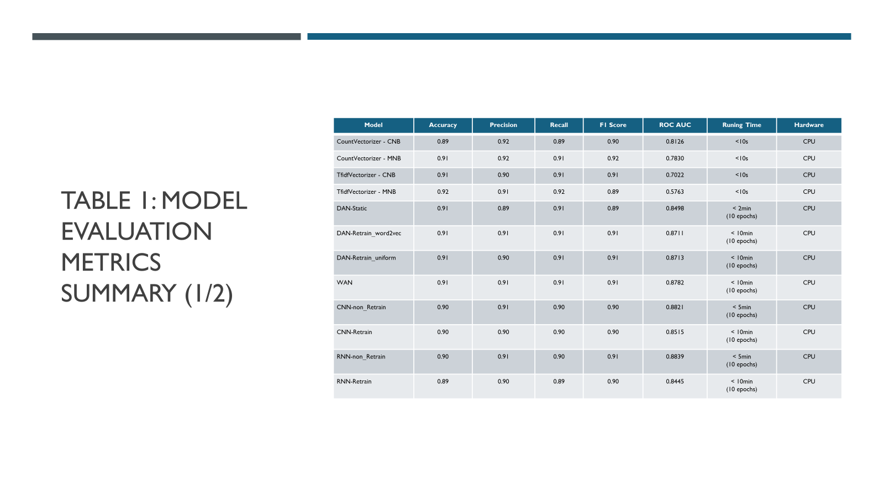
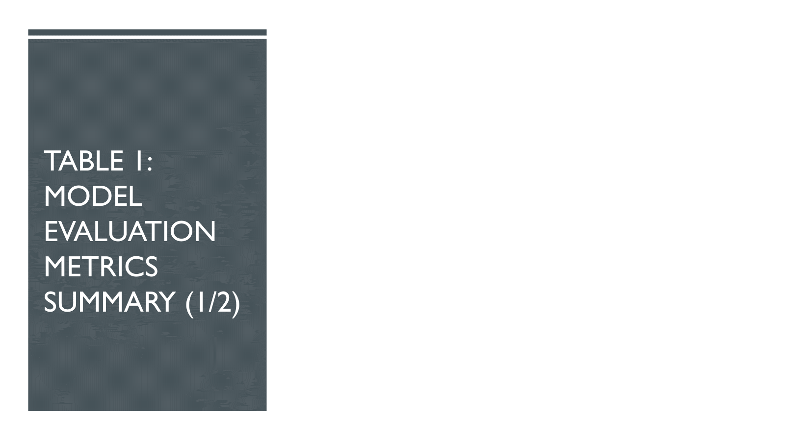
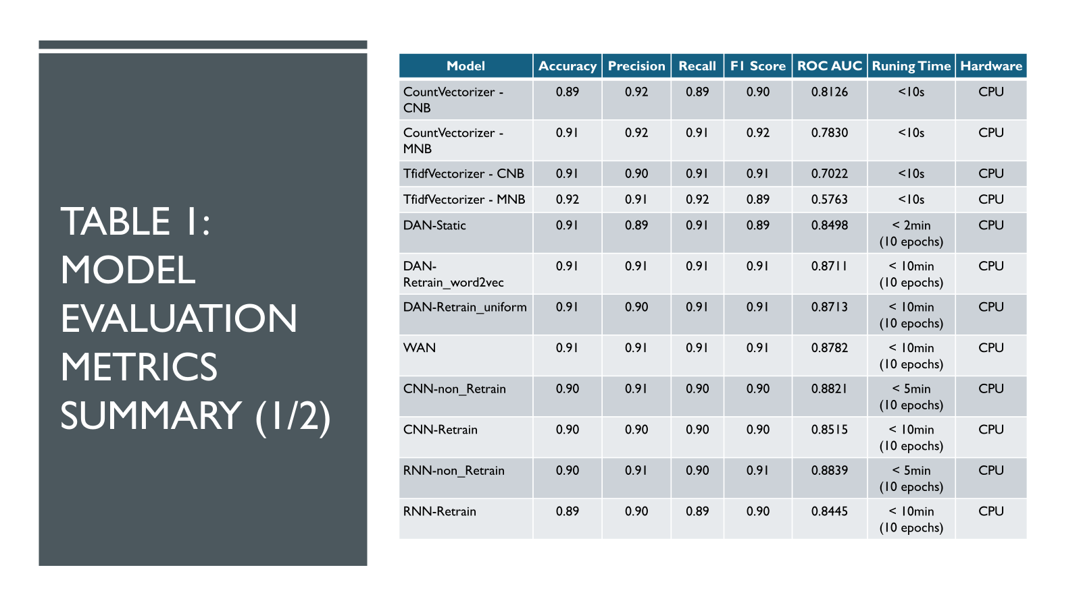
Appendix
APPENDIX

Slide 15
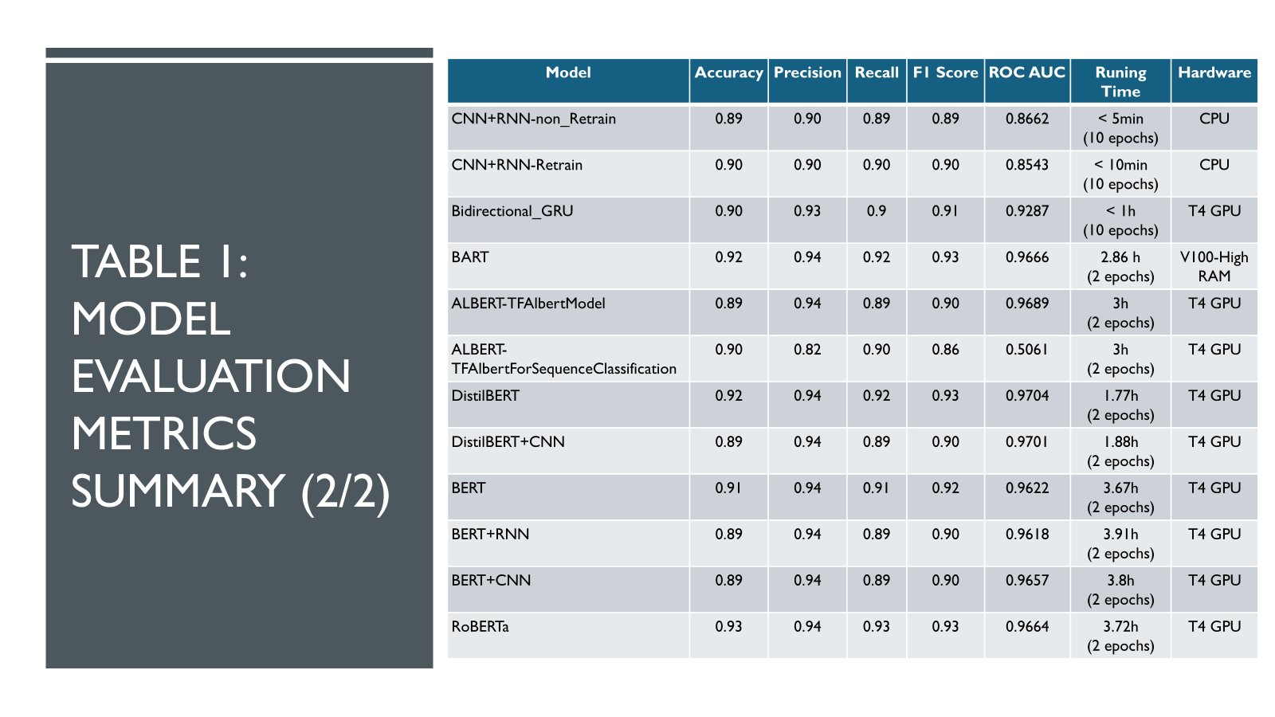

Slide 16

Thank You!

